Slide 1


INTRODUCTION TO AND
Ezgi Karaesmen April 2019 Pelotonia Fundraiser @ Columbus Collaboratory

Slide 2
Hello!
I am Ezgi! (Ez-ghee)
I am a PhD student at OSU, my research interests are Statistical Genetics and Pharmacogenomics.
And I am a Pelotonia Fellow! Email: Ezgi.Karaesmen@osumc.edu
Twitter: @e_Karaesmen
LinkedIn: www.linkedin.com/in/ezgi-karaesmen

Slide 3

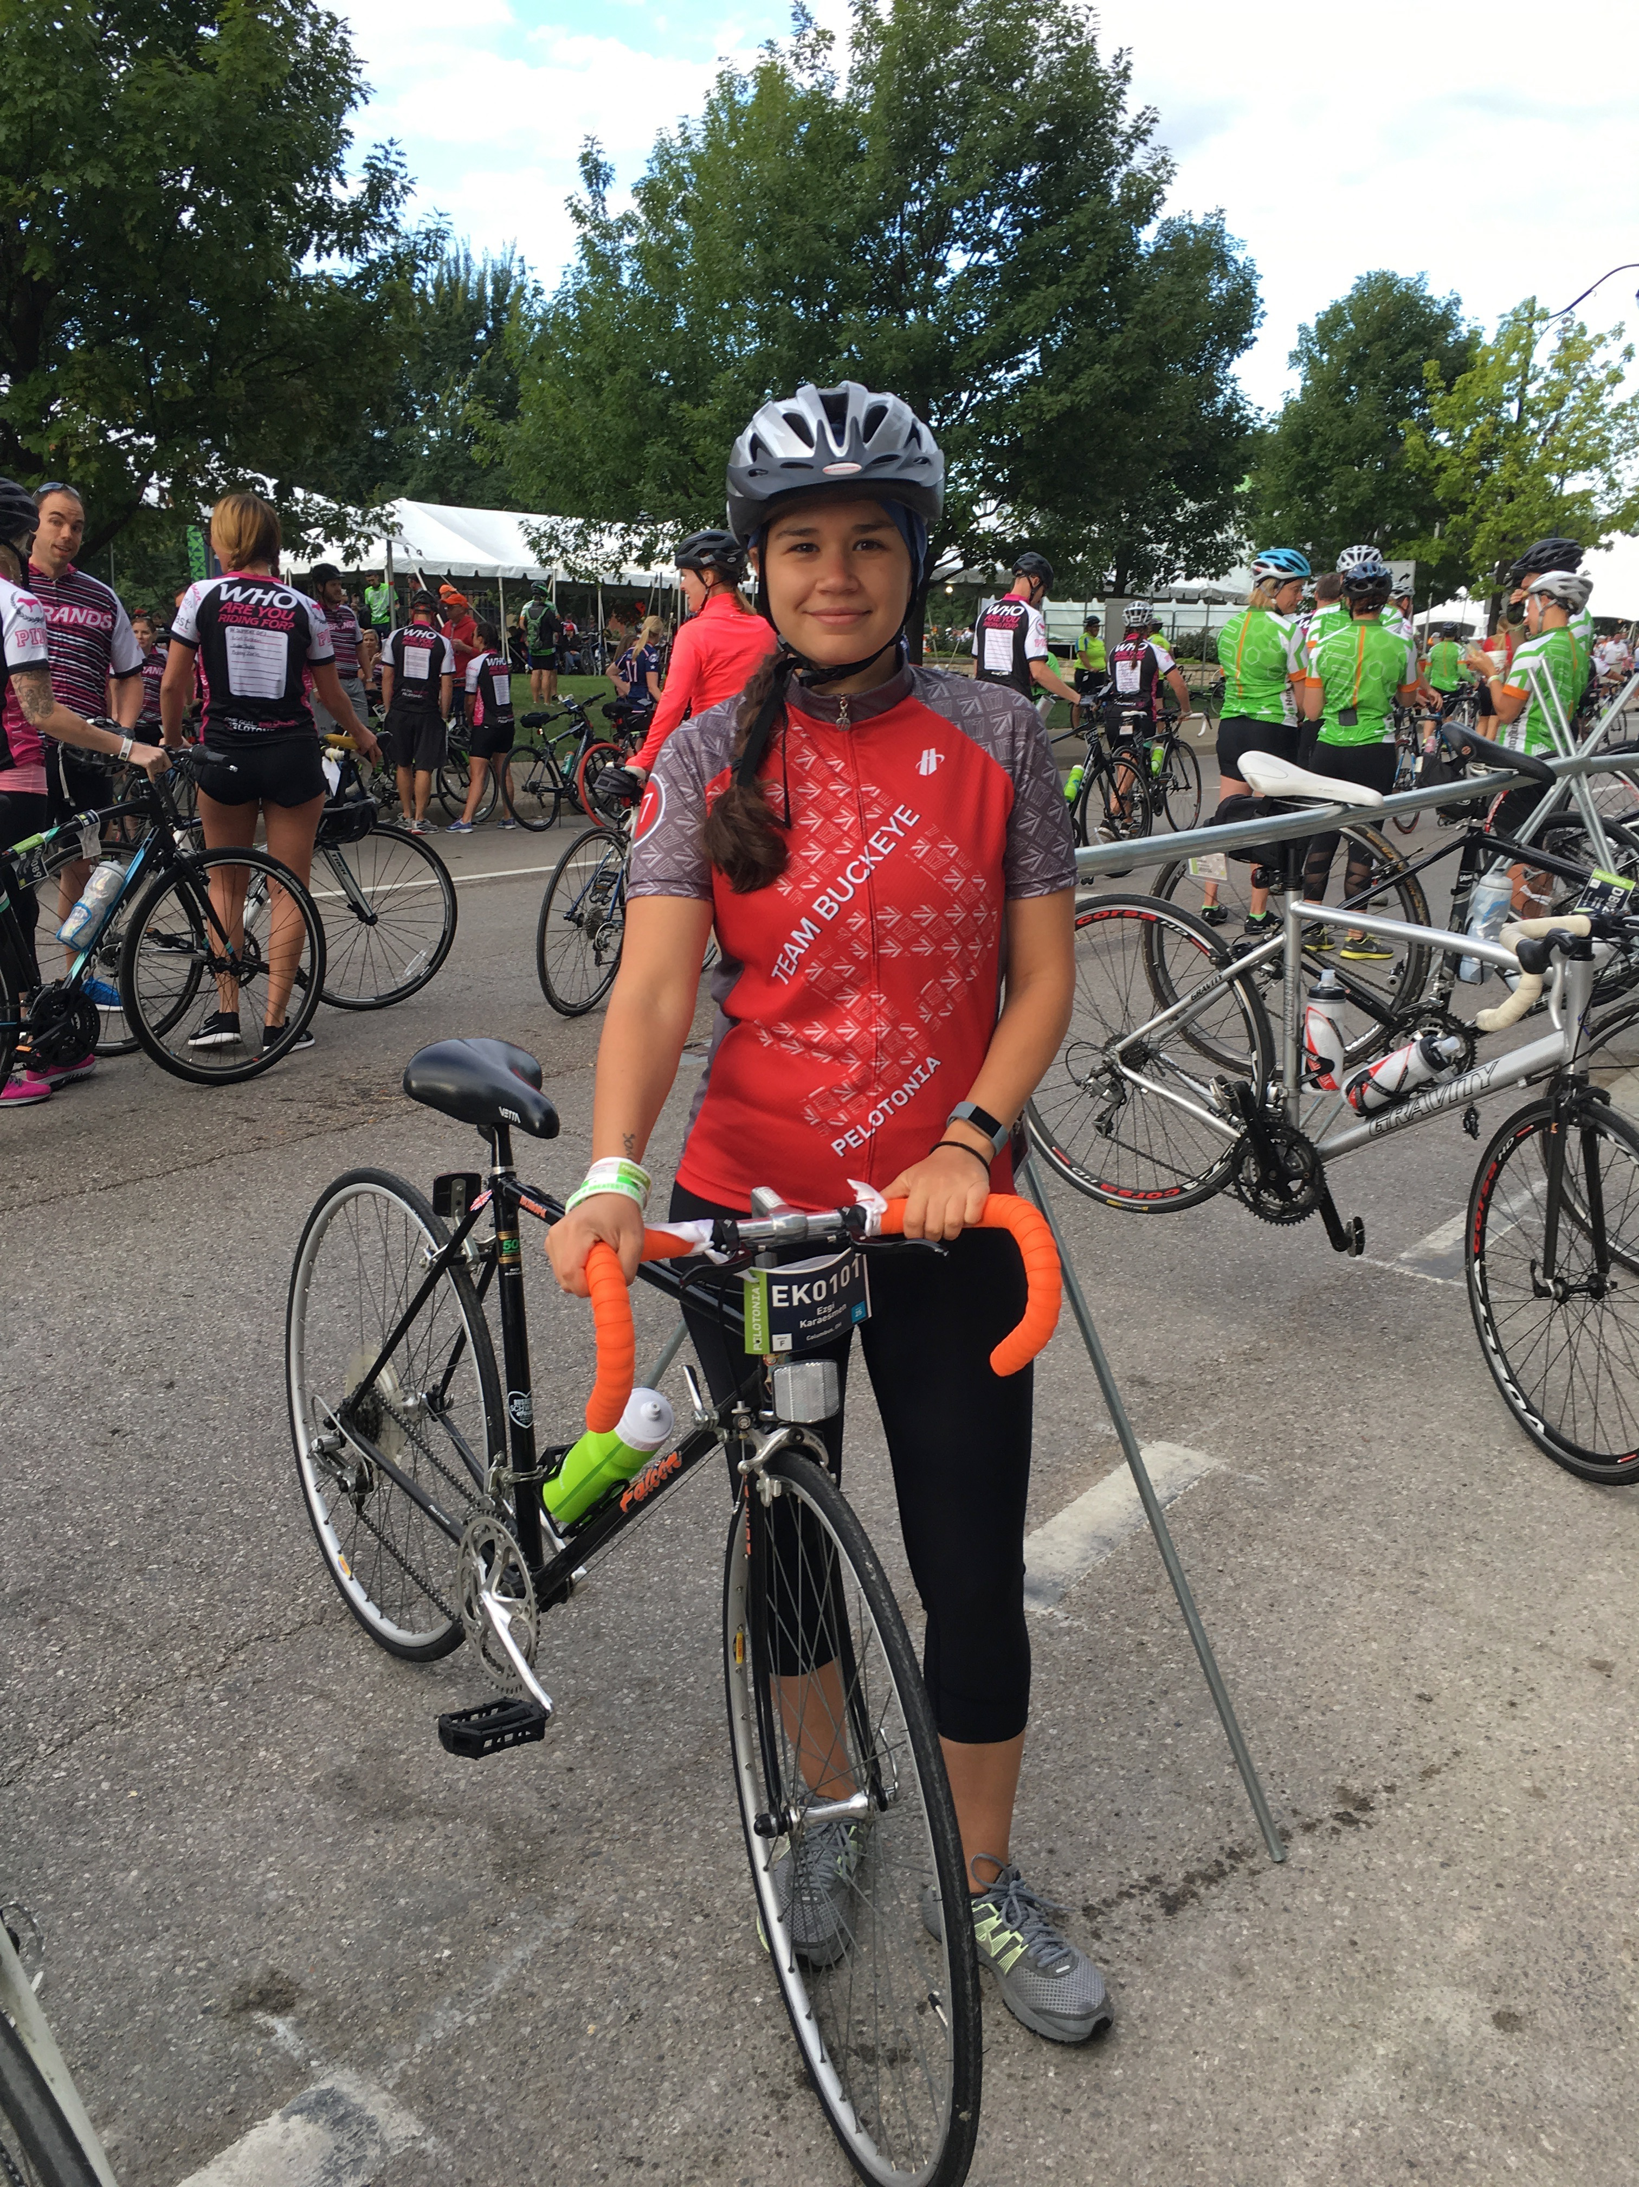
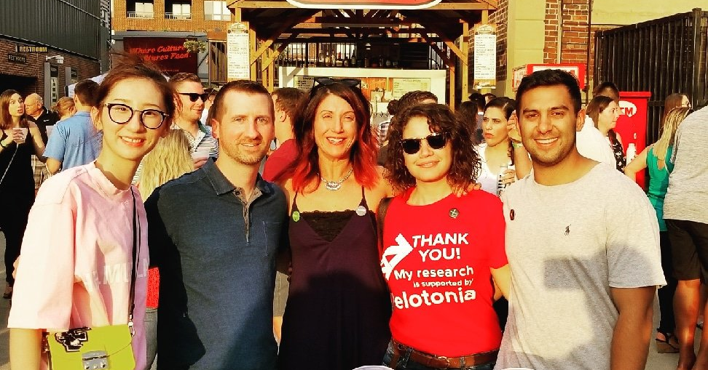
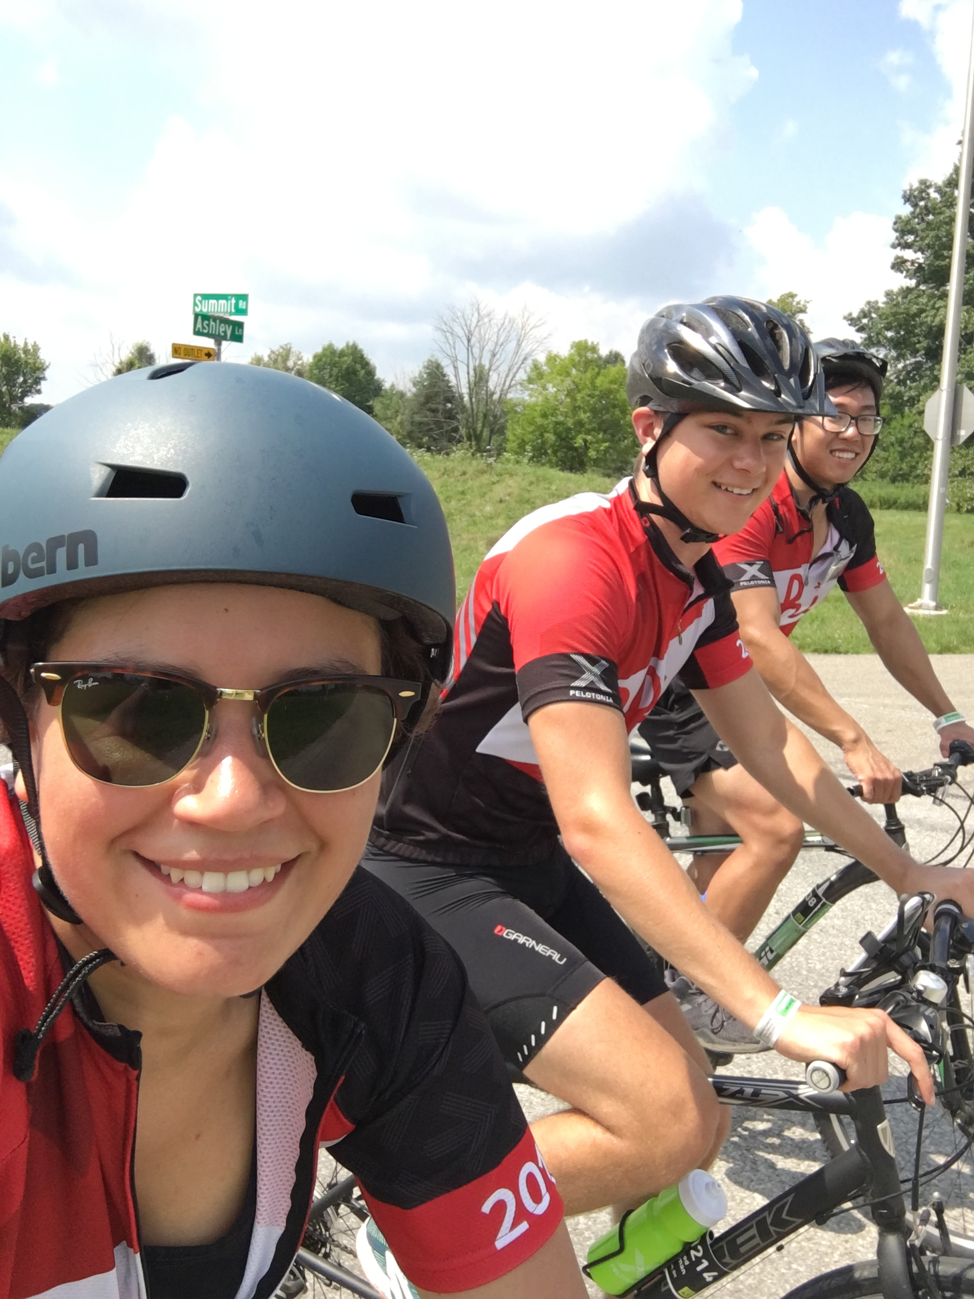

Slide 4

Who are the R-Ladies?
It’s me, it’s you, it’s all of us!
R-Ladies is a worldwide organization to promote gender diversity in the R community.
Our mission: To achieve proportionate representation by encouraging, inspiring, and empowering the minorities currently underrepresented in the R community.
As such, leadership and mentoring roles are reserved for women (including trans women, genderqueer women, and non-binary people who are significantly female-identified), and men are welcome to attend meetings as guests.

Slide 5
R-Ladies Columbus chapter
R-Ladies Columbus is the Columbus chapter of R-Ladies.
Current Co-Organizers: Ezgi (me) Katie Sasso (Data Scientist at Columbus Collaboratory)
Become a member : meetup.com/RLadies-Columbus/
Follow us on Twitter: @RLadiesColumbus

Slide 6
R and RStudio
Bonnie and Clyde of Statistical Programming

Slide 7

A Computer Programming Language
Free and open source programming language for statistical computing and graphics
Descends from S programming language
Created by oss Ihaka and obert Gentleman at the University of Auckland, New Zealand
Does not need RStudio

Slide 8
: A Sofware Program
If R is a pretty painting, Rstudio is the frame that enhances R’s beauty.
A free and open-source integrated development environment (IDE) for R
Built to help you write R code, run R code, and analyze data with R
Text editor, version control, latex integration, keyboard shortcuts, debugging tools, and much more

Slide 9

A Data Science Workflow
R for Data Science - Garrett Grolemund & Hadley Wickham

Slide 10
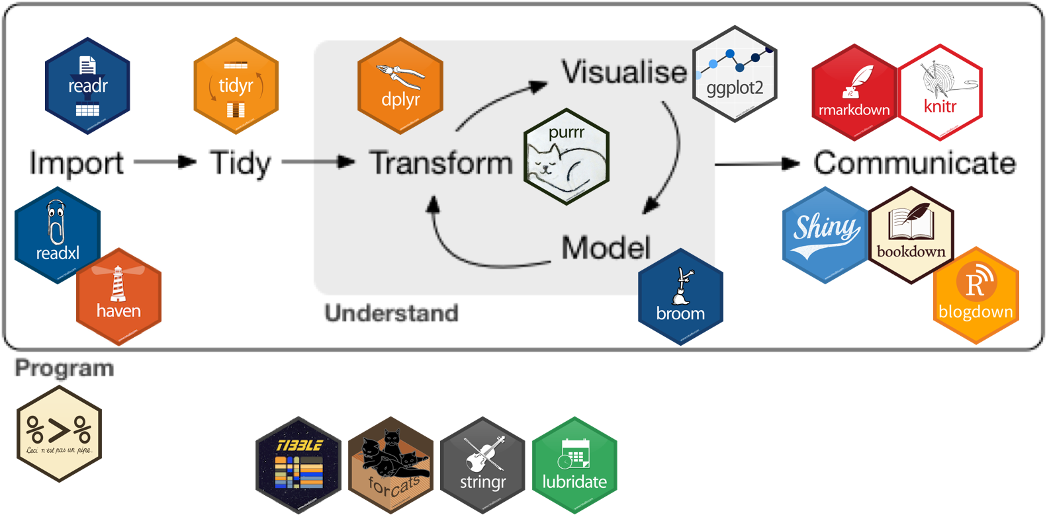

Why R is so awesome?

Slide 11
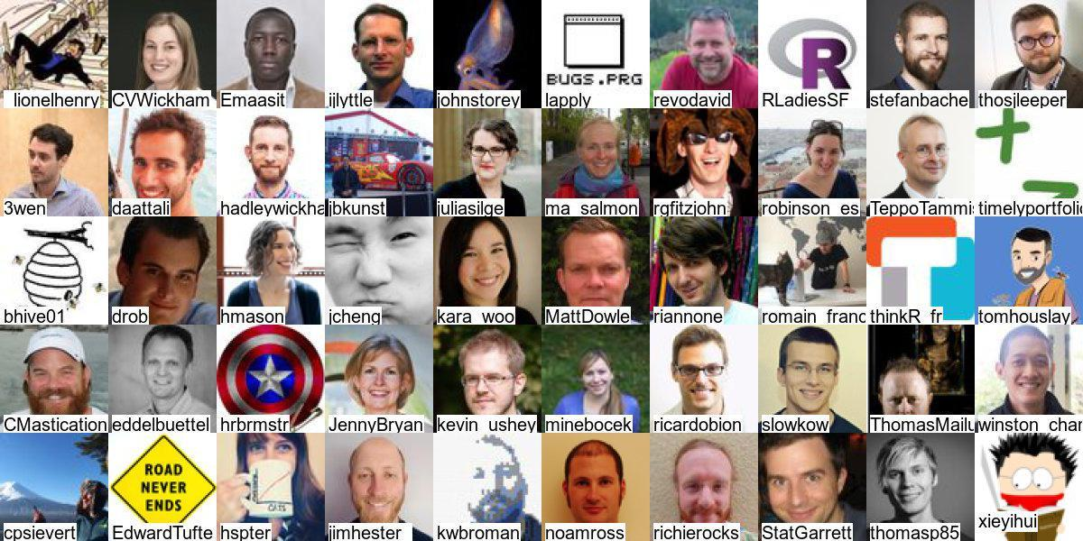
Why R is so awesome?
R community is the best!
#rstats and #rladies on Twitter

Slide 12
There are so many things one can do with R and RStudio
Data Visualization http://www.r-graph-gallery.com/portfolio/ggplot2-package/
Interactive Apps with Shiny
https://shiny.rstudio.com/gallery/
Reports and Books https://rmarkdown.rstudio.com/gallery.html

Slide 13


Some very useful links
R for Data Science Book – The Book! : https://r4ds.had.co.nz/
Introduction to Data Science Book: https://leanpub.com/datasciencebook
RStartHere: https://github.com/rstudio/RStartHere
#rstats on Twitter
DataCamp https://www.datacamp.com/
Learn more about what’s going on with DataCamp read:
https://juliasilge.com/blog/datacamp-misconduct/ https://medium.com/@heathernolis/on-datacamp-aafd82f94e60

Slide 14
Don’t forget!
This is like learning new language – it’s not so fun at the beginning but once you become good at it, it’s really useful (and fun, even sexy).
Prompting errors messages is the way R communicates with you. Although this may be frustrating, trying to understand what R is telling you is the only way to establish a healthy and happy relationship. ♥
Google is like a the couples therapist for you and R – never underestimate the power of Google

Slide 15
